Slide 1
Azure Cloudcamp
Juan Pablo Giraldo

Slide 2
El Repositorio
github.com/Ninja-Labs/azure
4. Application Insigths – HOL.A

Slide 3
Modern Application Lifecycle
Plan
Monitor + Learn
REQUIREMENTS
BACKLOG
Development
Production
Collaboration
Develop + Test
Release

Slide 4
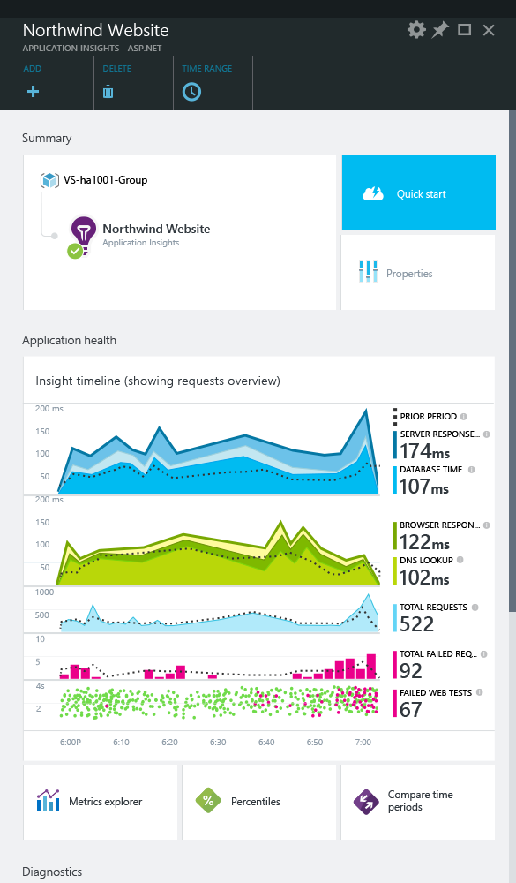

Application Insights
Application
Insights
1. Telemetry is collected at each tier: Mobile applications, server applications and browser
2. Telemetry arrives to Application Insights service where it is processed & stored
3. Get 360° view of the application covering availability, performance & usage

Slide 5
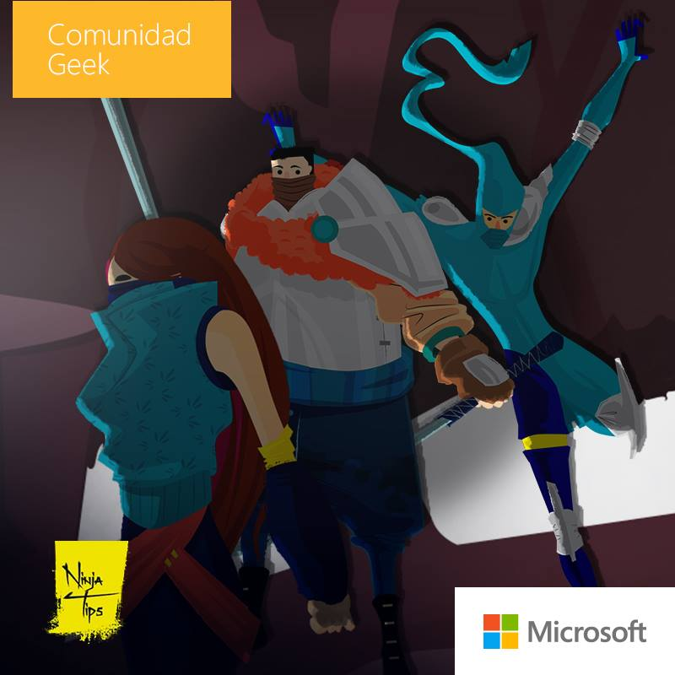
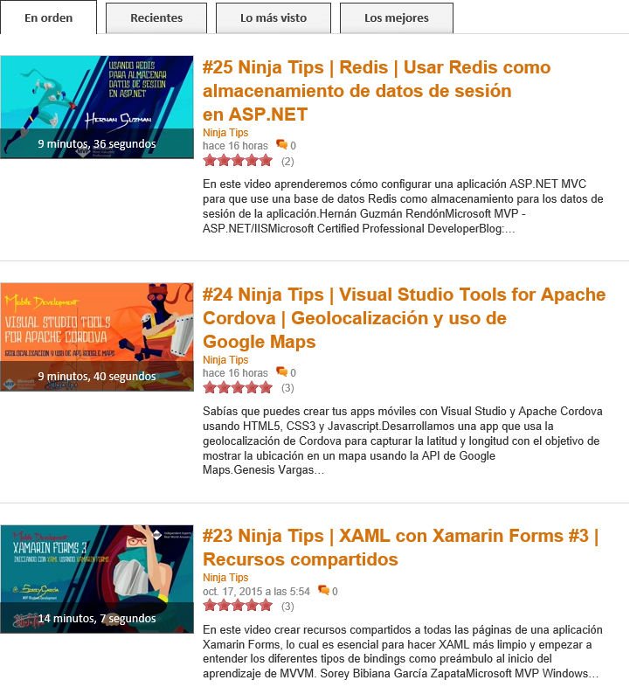

Ninja Tips - http://jkr.im/Ninja-Tips

Slide 6
Juan P. Giraldo
Software Team Lead @ Bizagi
http://lifeandcode.io
@qjuanp
https://co.linkedin.com/in/jpgiraldo

